Slide 1
Power BI Dashboard Summary
Name: Nitya Patel Date: April 18, 2025

Slide 2
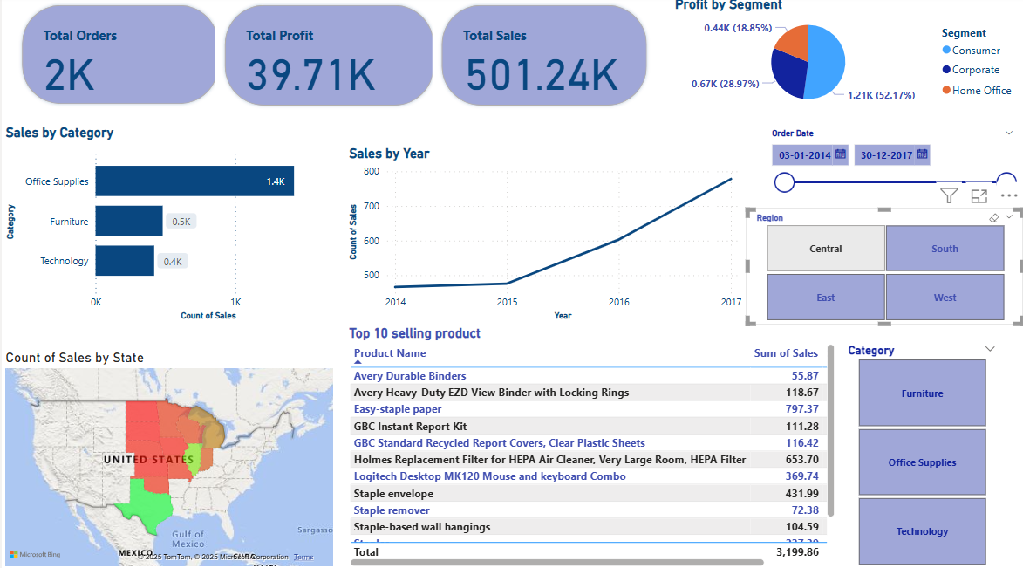
Title: Central Region Sales Overview
This chart highlights the sales distribution in the Central region. The visual shows that while the region has moderate performance, sales can be further improved in specific states with lower contributions. Focus areas can include increased marketing or better supply chain optimization.

Slide 3
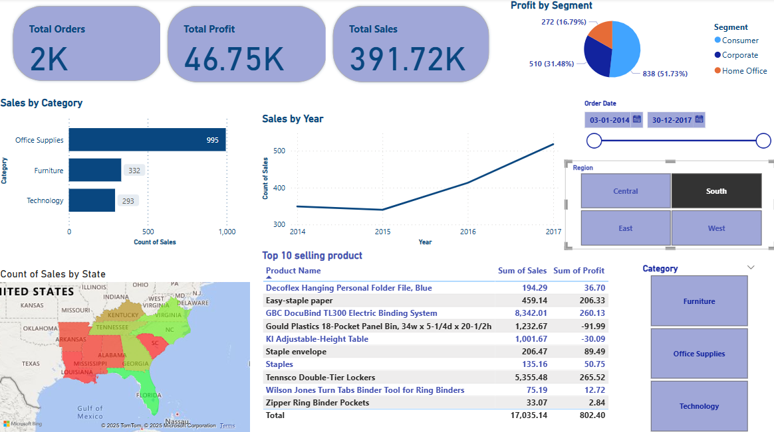
South Region Sales Overview
The South region exhibits mixed sales results. A few states perform very well, while others show relatively lower engagement. The data suggests an opportunity to leverage high-performing areas to uplift the rest.

Slide 4
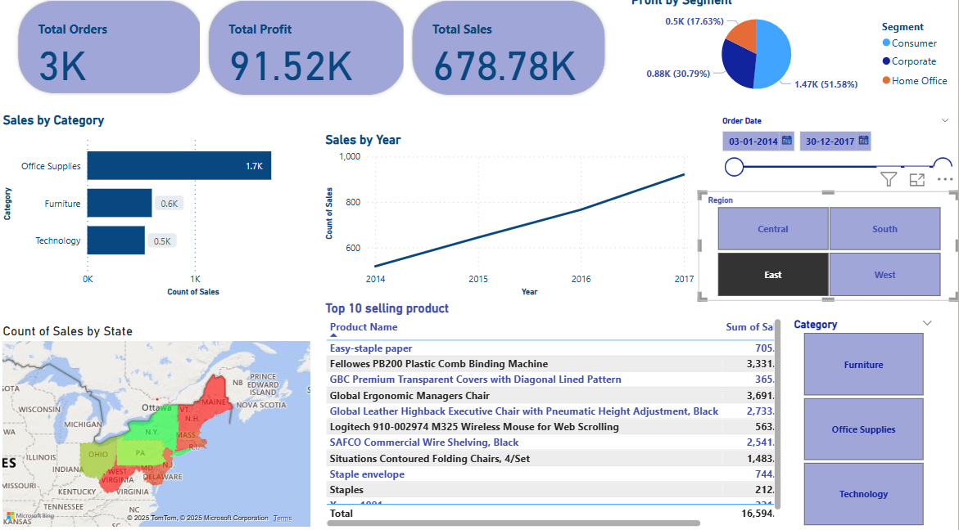
Title: East Region Sales Overview
East region shows strong and consistent performance. Most states contribute significantly to overall sales, indicating good product-market fit and effective regional strategies.

Slide 5
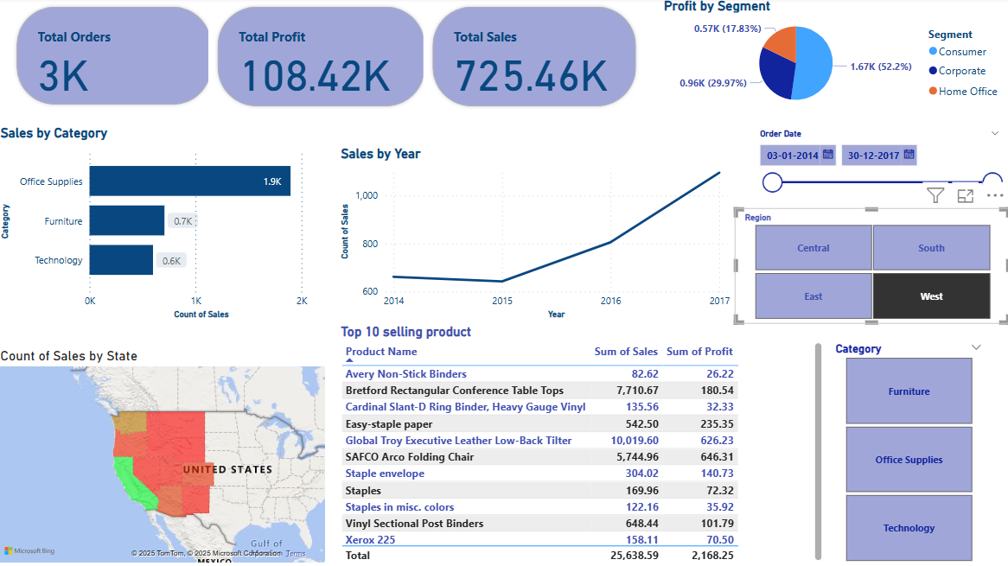
Title: West Region Sales Overview
The West region stands out with some of the highest sales figures. However, a few states lag behind. The dashboard helps identify these outliers for targeted interventions.

Slide 6
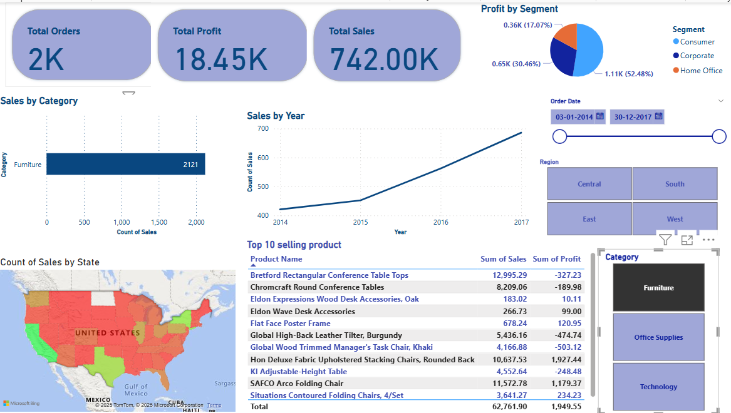
Title: Furniture Sales Overview
Furniture category has steady sales but slightly lower profitability. This insight can lead to revisiting pricing strategies or cost optimization to improve profit margins while maintaining volume.

Slide 7
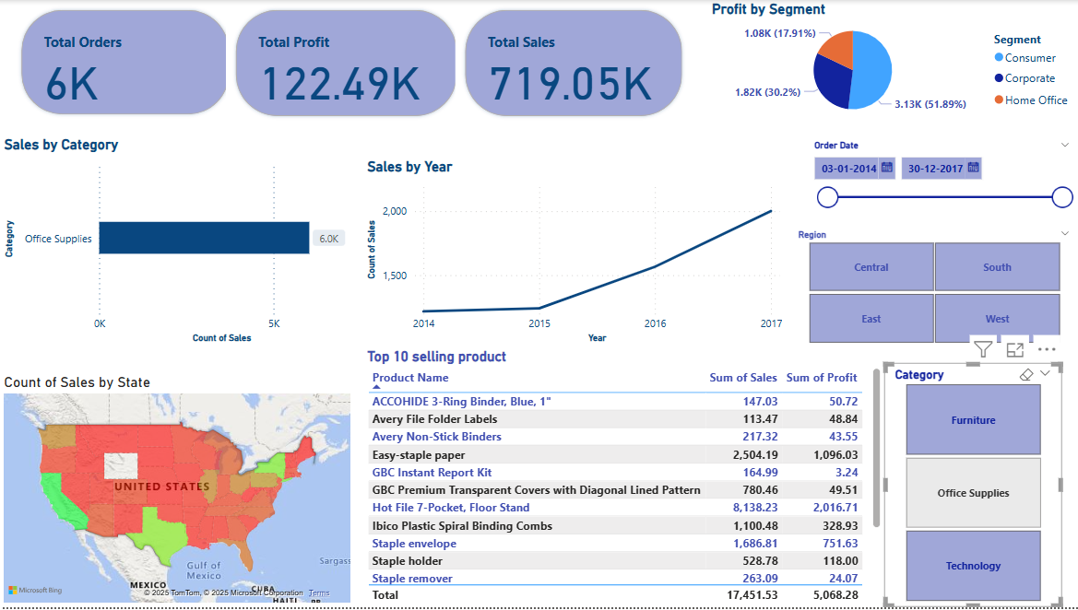
Title: Office Supplies Sales Overview
Office supplies show balanced sales and profit ratios. This segment has consistent demand and presents a reliable revenue stream with limited volatility.

Slide 8
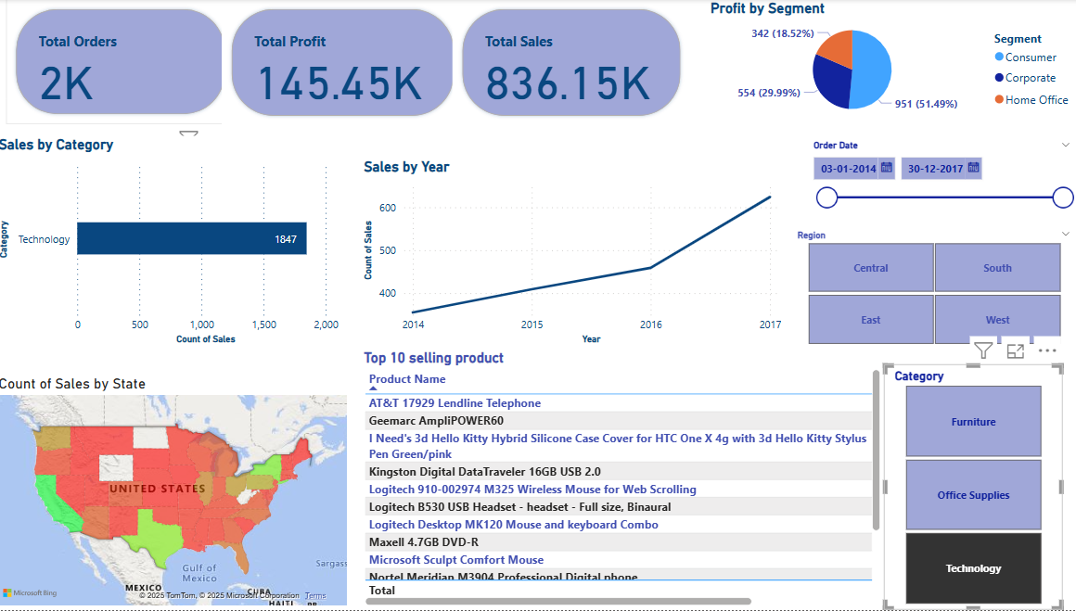
Title: Technology Sales Overview
Technology category leads in both sales and profit. This high-performing category is crucial for business growth. Efforts should be made to sustain this trend through innovation and customer targeting.

